Slide 1
US Department of Education Office of Elementary and Secondary Education Office of Safe and Supportive Schools
Annual Performance Reporting
July 14, 2025

Slide 2
Housekeeping
Annual Performance Reporting
GPRA Reporting and Tool
Questions
AGENDA

Slide 3
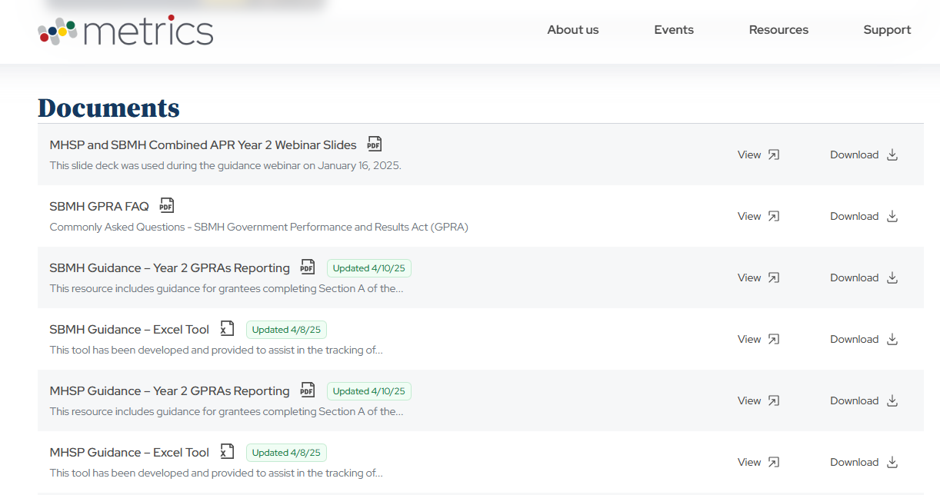
Frequently Asked Questions and GPRA Guidance
Available at: https://www.metricscenter.org/resources

Slide 4
Frequency
Grantees are required to submit:
Annual Performance Report (APR) – annually, except final year
Final Performance Report (FPR) – final year only
Annual and Final Performance Reports are submitted through G5

Slide 5
Annual Performance Report
(via G5)
August 15, 2025
Reporting period for this APR is:
January 1 – July 15, 2025

Slide 6
Key Components
Your APR should include:
GPRA PROGRESS
GPRA data and description of your progress toward meeting GPRA Measures and project goals and objectives during the reporting period. GPRA data and a description of the data is required. If you included individual grant project goals and objectives, please report on those also.
FISCAL UPDATES & PROJECTION
A description of grant funds expended within the reporting period, a projection of what will be spent, and anticipated carryover (unspent) funds by the end of the grant year.
We will provide an optional budget spreadsheet.

Slide 7
ED524B Reporting Form
The ED524B is the official reporting form used for discretionary grants at ED.
The form includes instructions and 5 distinct sections:
1-Cover Sheet
2-Executive Summary
3-Section A
4-Section B
5-Section C
You may access these forms and instructions online at: http://www.ed.gov/fund/grant/apply/appforms/appforms.html

Slide 8
ED 524B – Executive Summary
In this section, you will provide a 1-2 page general summary of your grant activities.
You should highlight progress towards your project’s goals, and the extent to which expected outcomes and performance measures were achieved.
If project goals and objectives are not being met, you should include information about the challenges affecting implementation.

Slide 9
ED 524B Cover Sheet
The reporting period is January 1, 2025 – July 15, 2025. Please do not alter these dates.
Consult with your business office to complete financial sections of the report, including budget expenditures and indirect cost rates.
The Human Subjects question (#10) and the Data Privacy question (#11) are not required.

Slide 10
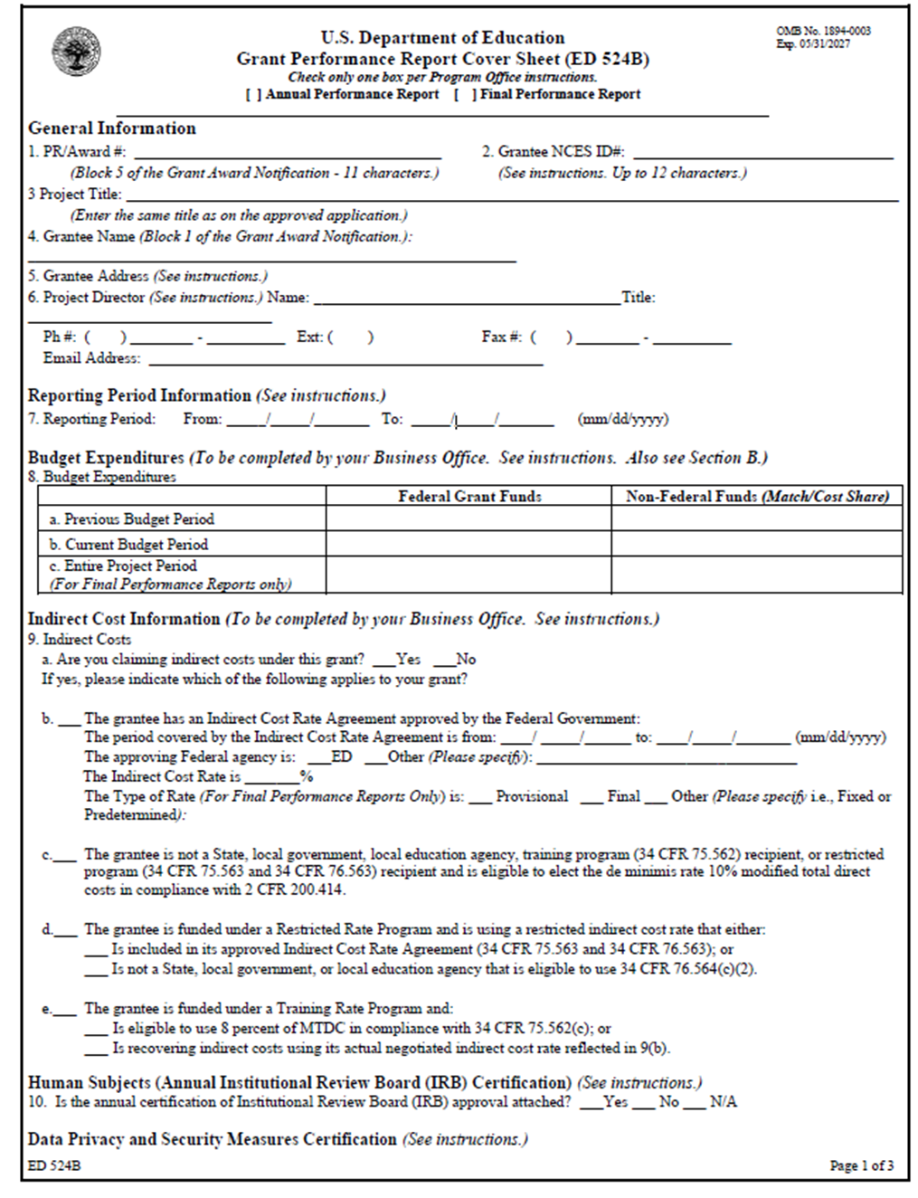

Slide 11
ED524B Reporting Form – Cover Sheet
You cannot complete line a for your first report, but be sure to complete line 8b & c.
The Reporting Period for this report is:
01/01/2025 – 07/15/2025

Slide 12
ED 524B – Section A (Project Status)
This section requires you to report data for BOTH “Program” and “GPRA” measures.
GPRA measures are established – please do not change the GPRA language in the Performance Measure section.
When entering data in the “Actual Performance Data” section, please include the Raw Score.

Slide 13
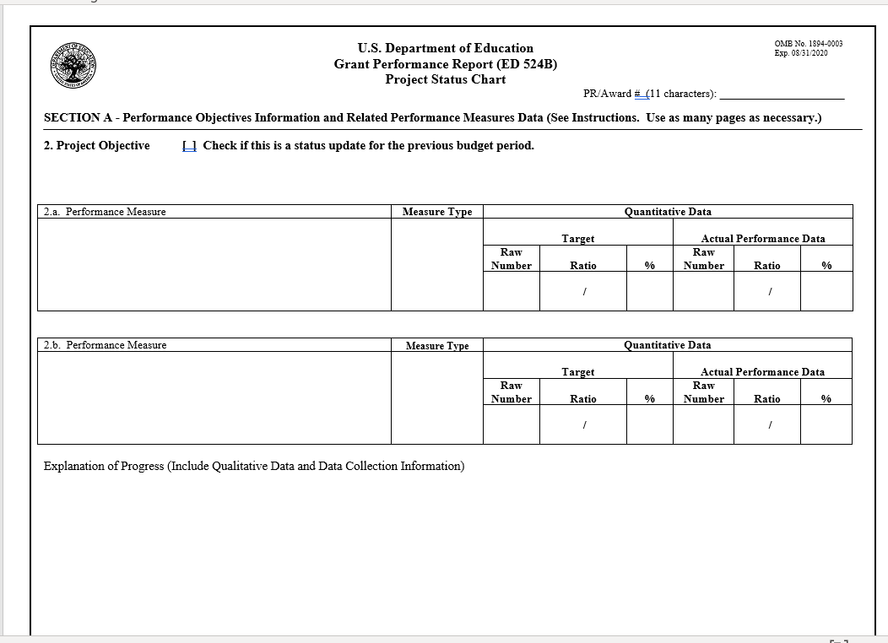

Slide 14
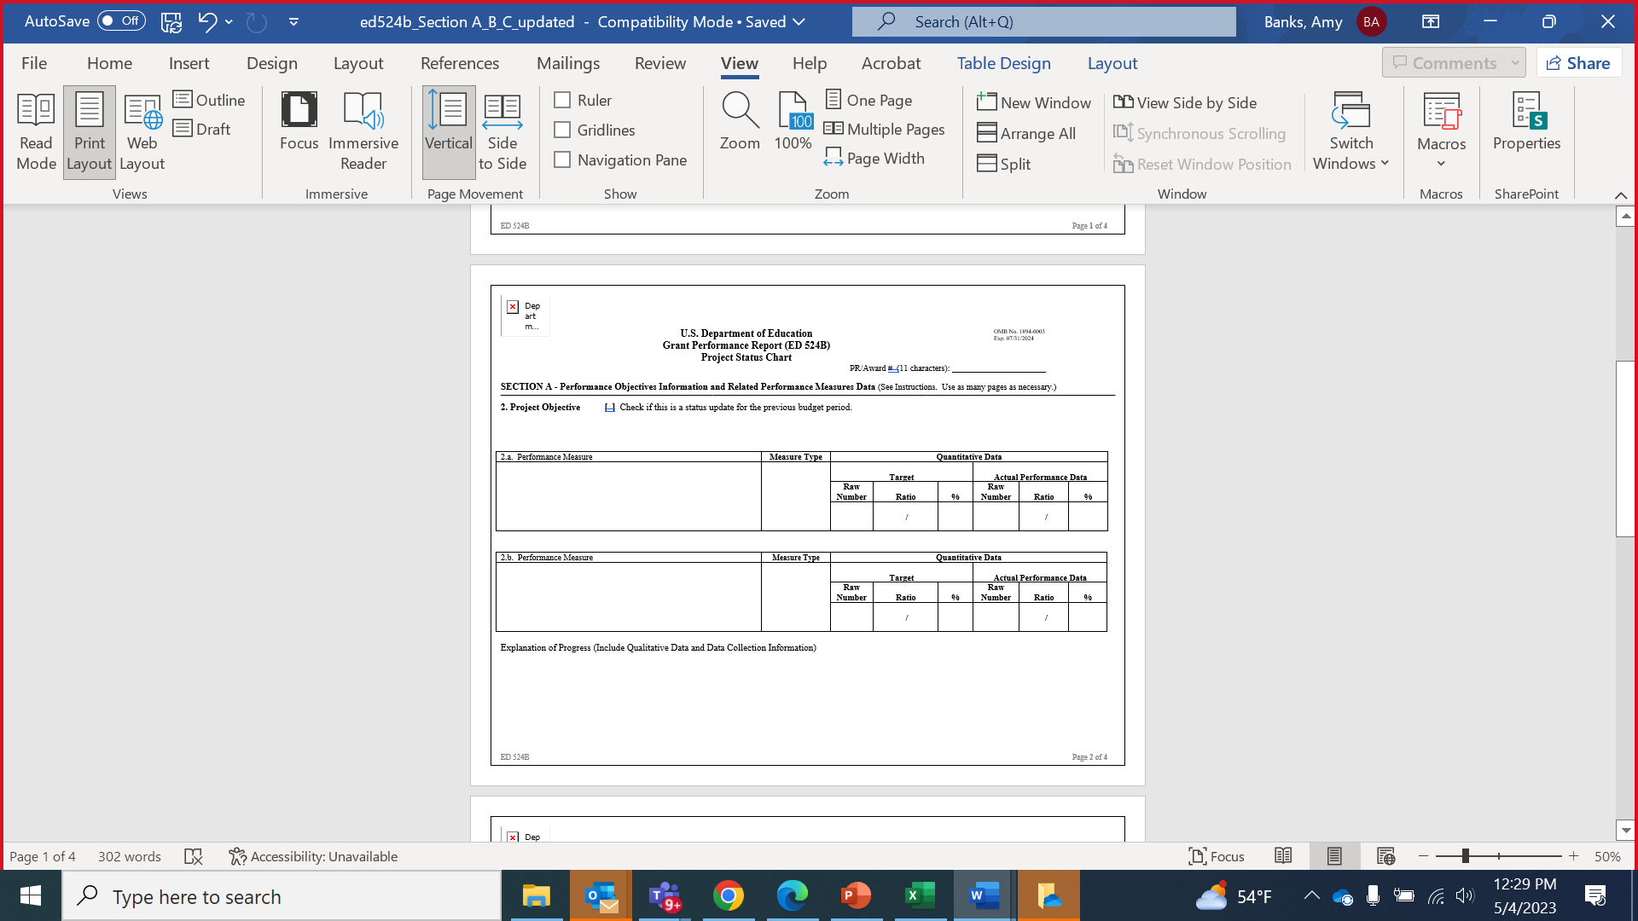

ED 524B Section A:
Progress Status Charts: (Required)
List the GPRA Performance Measure and Measure Type: (and Project if applicable) only
Explanation of Progress:
(Required)
Provide a written explanation of your progress so far towards
each GPRA measure and
any individual project measures established in your application.

Slide 15
ED 524B: Section A (Project Status)
Use the Project Status Charts to input the Performance Measure and Measure Type (GPRA or Project).
Use the Explanation of Progress sections to explain the progress you have made on each of the GPRA measures and any individual project measures you may have included in your application.
If necessary, you may create multiple pages of Section A.

Slide 16
ED 524B – Section A (Project Status charts)
Use the Explanation of Progress section to provide details (i.e.):
Data-collection procedures,
Data explanations,
Response rates, etc.

Slide 17

MHSP GPRA Overview
Training
Placement
Hiring

Slide 18

Key Definition
MHSP Program
Unduplicated:
Counts for GPRAs 1, 2, and 3 should be unduplicated. Thus, if you count a provider toward a GPRA in your Year 1 APR, they should not be counted toward that same GPRA in the Year 2 APR.

Slide 19
GPRA 1: Training
MHSP Program
The unduplicated, cumulative number of school-based mental health services providers trained by the grantee under the project to provide school-based mental health services in high-need LEAs.
GPRA 1A: Completed Training
GPRA 1B: In Training (but not complete)
Explanation of Progress:
Describe any successes or challenges in the training process, such as those related to the recruitment and retention of trainees. Also provide information on the nature of training being provided.

Slide 20
GPRA 2: Placement
MHSP Program
The unduplicated, cumulative number of school-based mental health services providers placed in a practicum or internship by the grantee in high-need LEAs to provide school-based mental health services.
GPRA 2A: In Placement
GPRA 2B: Completed All Placements
Explanation of Progress
Describe any successes or challenges in the practicum or internship process. Also, provide information on the nature of the practicum and internship experiences.
Notes:
GPRA 2A:
A trainee did not need to complete the practicum experience to be included in this count; they just needed to be placed.
If a trainee was placed in practicum during the start of the reporting period and transitioned to internship by the end of the reporting period, that trainee is still only counted once under GPRA 2A. Similarly, if the trainee changed practicum or internship placements during this reporting period, they are only counted once toward GPRA 2A.
GPRA 2B:
If a student completed their required practicum during this reporting period but still needs to complete an internship to receive their degree, they should not be counted toward GPRA 2B during this reporting period.
If a student completed their practicum during a previous reporting period and then completed their internship during this reporting period (thus ending all placement requirements), they can be counted toward GPRA 2B.

Slide 21
GPRA 3: Hiring
MHSP Program
The unduplicated, cumulative number of school-based mental health services providers hired by high-need LEAs to provide school-based mental health services.
GPRA 3A: Hired
GPRA 3B: Retained
Because this is the first year of the project, this number should be zero, as there was no one to retain from a previous reporting period.
Explanation of Progress
Describe any successes or challenges in the hiring process. Also note if this GPRA is not yet relevant to your project if all trainees were still in training during this reporting period.
Notes:
GPRA 3A
If a trainee was hired but left the position before the end of the reporting period, they should still be counted under GPRA 3A.
GPRA 3B
Because this is the first year of the project, this number should be 0, as there was no one to retain from a previous reporting period.

Slide 22
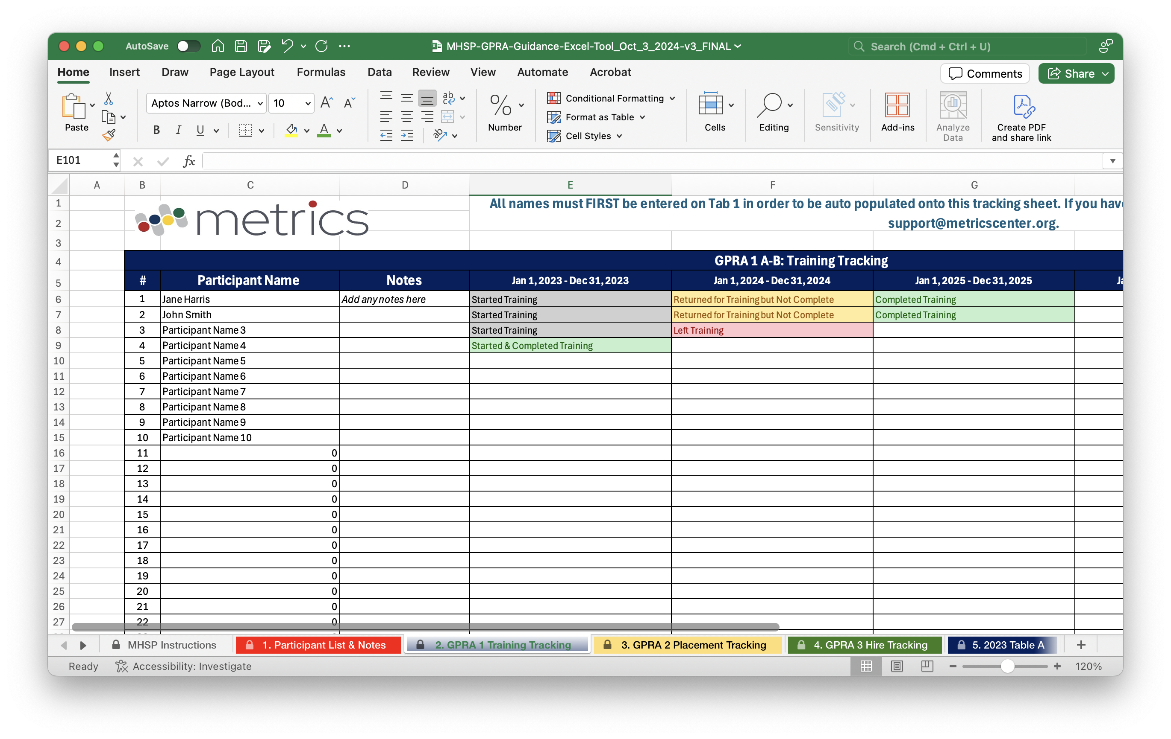
GPRA Guidance Tool
MHSP Program

Slide 23
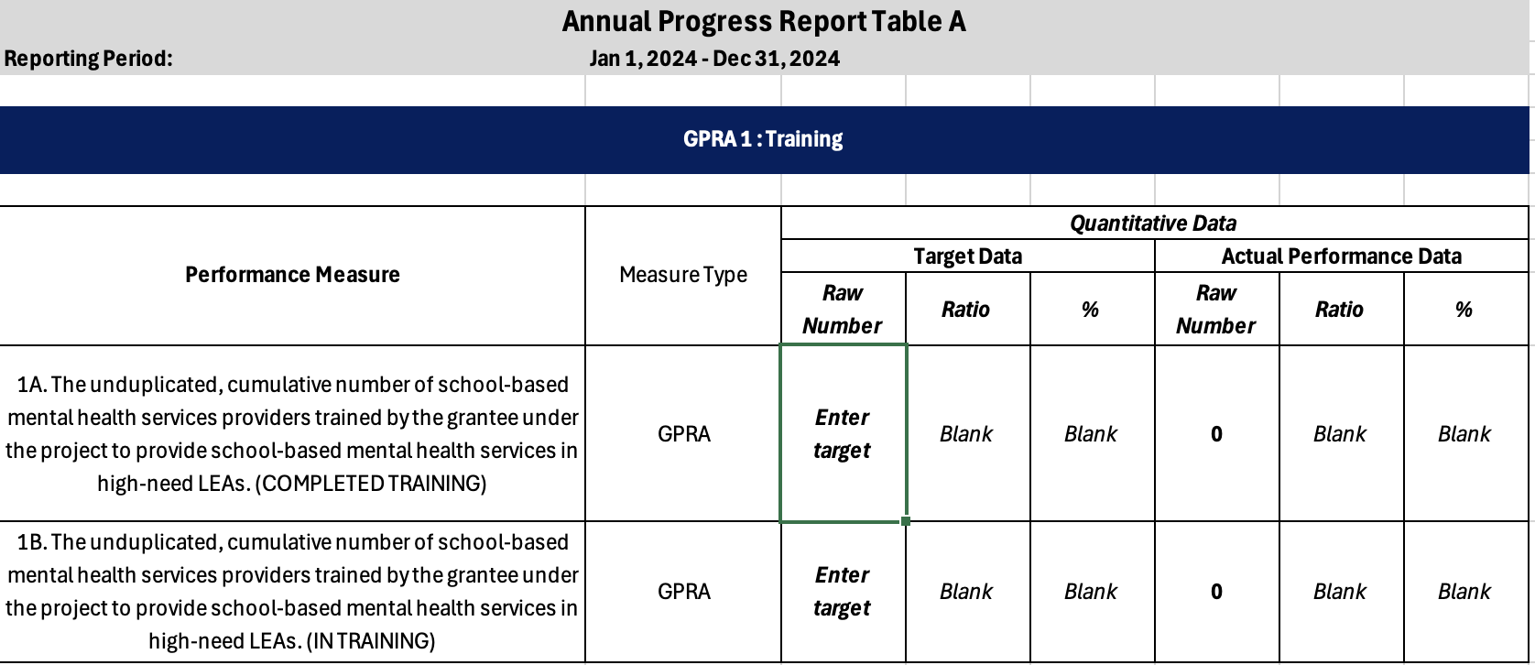
GPRA Guidance Tool
MHSP Program

Slide 24
SBMH GPRA Overview
New Hires
Retained
Student/Provider Ratio
Attrition
Students Served

Slide 25
Key Definition
SBMH Program
Unduplicated: Counts for GPRAs 1, 2, and 3 should be unduplicated. Thus, if you count a provider toward a GPRA in your Year 1 APR, they should not be counted toward that same GPRA in the Year 2 APR.

Slide 26
GPRA 1: New Hires
SBMH Program
The unduplicated, cumulative number of new school-based mental health services providers hired for each LEA with demonstrated need as a result of the grant.
Please include only whole numbers in the data chart, rounding down if necessary (e.g., 6.5 FTE hired = 6 FTE in the data chart).
Explanation of Progress:
List the number of providers hired using grant/matching funds in each participating LEA (e.g., LEA 1 = X hired).
Please write the exact number of full-time equivalency (FTE) of the hired providers. For instance, you could list the total number of providers hired at .50 FTE and the number at 1.00 FTE for each LEA. (e.g., 6.5 FTE)
You could also describe any successes or challenges in hiring providers.
Notes:
The number of new providers hired across all participating LEAs.
This count should include providers hired through activities or incentives implemented using grant or matching funds.
Note: It is not possible to enter decimals into Section A within G5/G6. Therefore, round down to the nearest whole number when entering information into the table depicted above. Then, report the exact decimal number in the Explanation of Progress.
For example, if you hired two 1.0 FTE providers and one 0.5 FTE provider, enter “2” into the table while specifying you hired “2.5” providers in the Explanation of Progress.

Slide 27
GPRA 2: Retained
SBMH Program
The unduplicated, cumulative number of school-based mental health services providers retained in LEAs with demonstrated need as a result of the grant.
Start with a baseline of the number of providers in the school year prior to the current reporting year.
Explanation of Progress
Note which activities or strategies were used to support retention. Examples might include retention bonuses, professional development opportunities, and mentorship programs.
Notes:
The Year 1 target should reflect the number provided in your approved application.
Providers counted in the actual number should be those funded through the grant or matching funds or who were retained through activities or strategies funded through the grant or matching funds.

Slide 28
GPRA 3: Student/Provider Ratio
SBMH Program
The ratio of students to school-based mental health services providers for each LEA with demonstrated need served by the grant, and the numbers of school-based mental health services providers and students used to calculate the ratio.
Explanation of Progress
List the ratio of students to providers within each participating LEA (e.g., LEA 1 = A/B).
Notes:
Report the ratio of students to providers across all participating LEAs: student enrollment (A)/providers(B) = A/B. For example, if there are 3,249 students and 12 providers across the participating LEAs, the ratio would be 3,249/12.
Note: G5/G6 will automatically calculate other data entries (e.g., percent) when entering ratio information. Only input the ratio information and ignore any other automatic inputs.

Slide 29
GPRA 4: Attrition
SBMH Program
The attrition rate of school-based mental health providers for each LEA with a demonstrated need that is participating in the grant.
For Year 1, the actual attrition number should be zero.
Explanation of Progress
“As directed by ED, the target and actual numbers for Year 1 are a baseline of 0.”

Slide 30
GPRA 5: Students Served
SBMH Program
The total number of students who received school-based mental health services as a result of the grant.
Explanation of Progress
Describe what services were provided and how grant or matching funds supported them.
Notes:
Report the number of students who received school-based mental health services within this reporting period due to the grant. These services could include Tier 1 (whole school), Tier 2 (small group), or Tier 3 (individual) practices.
The GPRA 5 count does not need to be unduplicated like some of the other GPRAs.
Thus, if a student received services in Year 1 and was counted toward GPRA 5, they can still be counted under GPRA 5 in the Year 2 APR if they also received services in Year 2.

Slide 31
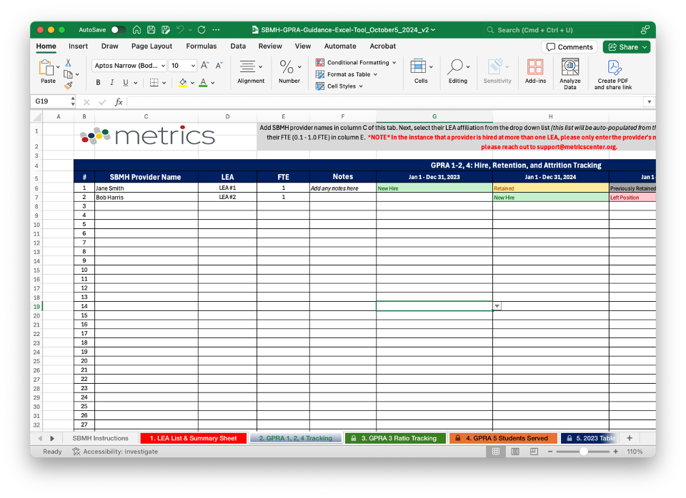
GPRA Guidance Tool
SBMH Program

Slide 32
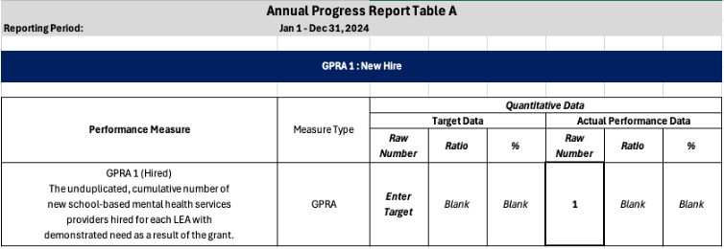
GPRA Guidance Tool
SBMH Program

Slide 33
ED 524B – Section B (Budget)
Please use this section to discuss all spending for the reporting period. The reporting period for this APR is:
January 1, 2025 – July 15, 2025
We will also provide you with a Budget Expenditure Spreadsheet . We encourage you to use this sheet, as it can provide some detailed information pertinent to our review of your report.
NOTE: The suggested spreadsheet does not replace the narrative you are to provide in Section B.
Section B must provide:
Budget data and a written description of grant funds expended within the reporting period;
A projection of what will be spent by the end of the grant year (December 31st); and
Any anticipated carryover funds (funds unspent as of December 31st) that you propose to be expended and on which activities, and when you propose the funds to be spent.

Slide 34
ED 524B – Section C
FOR THIS REPORT, USE SECTION C TO ADDRESS THE FOLLOWING:
Provide list of IHE or high-need LEA partners. (Only MHSP grantees)
Identify grant activities that were not implemented due to unforeseen activities. (MHSP and SBMH)
Detail any challenges to grant activities. (MHSP and SBMH)
Provide any information (or good news!) you would like to share with us that is not covered elsewhere in the report. (MHSP and SBMH)
Include a statement ensuring that the two Program Requirements outlined in the Notice Inviting Applications (NIA) are met (providers are credentialed by the State and provide services in accordance with the requisite Federal, State, and local laws). (Only SBMH grantees)
Notes:
SBMH Program Requirements:
(a) Applicants that receive an award under this program must ensure that any school-based mental health services provider hired under this grant, including any services provider that offers telehealth services, is credentialed by the State to work in an elementary school (as defined in 20 U.S.C. 7801(19)) or secondary school (as defined in 20 U.S.C. 7801(45)).
(b) Applicants that receive an award under this program must ensure that any school-based mental health services provider offering services (including telehealth services) does so in an equitable manner and consistent with the Family Educational Rights and Privacy Act (FERPA), the Protection of Pupil Rights Amendment (PPRA), the Individuals with Disabilities Education Act (IDEA), Section 504 of the Rehabilitation Act, and the Americans with Disabilities Act, as well as all other applicable Federal, State, and local laws.

Slide 35
Key APR Requirements: Summary
Cover sheet and Executive Summary: A completed Cover Sheet including a copy of your indirect cost rate agreement (if claiming indirect costs) and 1-2 page Executive Summary highlighting the successes and challenges experienced this reporting period.
Section A: Data in the Project Status Charts and a written description of your progress toward meeting each GPRA measure in the Explanation of Progress sections. You must do the same for any program-specific Project Measures. GPRA and Project Measure data are required for the APR.
Section B: Relevant financial data (including matching funds for SBMH grantees) and a written description of the data, including detailed budget expenditures information for the reporting period. The provided budget spreadsheets are optional.
Section C: This is a catch-all section for program-specific information, and for indicating any pertinent grant information not provided elsewhere in the report.

Slide 36

When sending emails to your Federal Project Officer, please include your PR award # in the subject line.

Slide 37

Exit Ticket
How did we do?

Slide 38

Questions….
38

